Slide 1
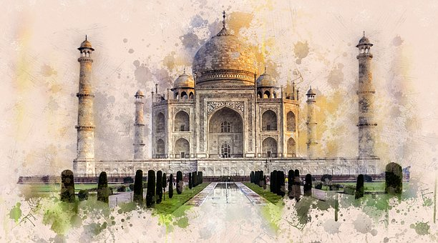
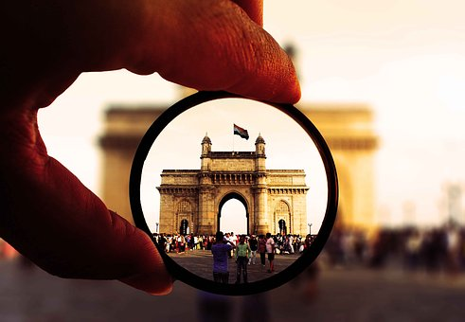
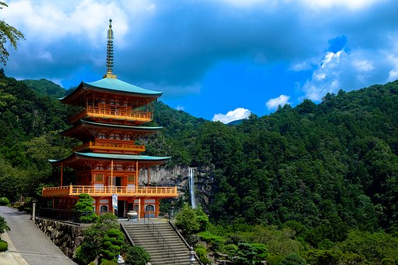

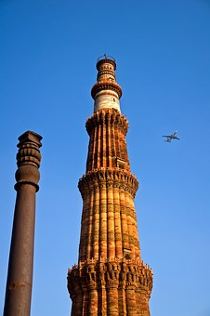
TCSへようこそ！ Welcome to TCS
Notes:
1
1

Slide 2
Customer Executives
Mr. Yoshihiro Hatano : Senior Managing Executive Officer and CIO, Executive General Manager of Digital Innovation Partners, Executive General Managerof Operation Transformation
Mr. Tomohiro Fujii : School Company System Solutions Division, GM of School Systems Management Department
Mr. Kenji Naramura : School Company System Solutions Division, School Systems Management Department, Manager of School Systems Management Division
Ms. Marie Ashida : GM of GTEC Global Business Development Department
TCS Team
Pune
Mr. Milind Karve – Service Delivery Head & VP, JDC
Mr. Tetsuya Nakamura – Chief Digital Innovation Officer, TCS Japan
Mr. Arvind Kumar – Segment Head, Manufacturing, TCS Japan
Mr. Laxmikant Shaligram – Deputy Service Delivery Head & Industry Leader, MFG
Mr. Sagar Borgaonkar – Head of Presales & Strategic Initiatives, JDC
Mr. Santhosh Kumar Basavaraj Benkipurada – Client Partner, TCS Japan
Mr. Soumen Bag – Delivery Partner, MFG, JDC
Ms. Nivedita Kulkarni – Early Engagement Solution Architect, JDC
Mr. Avinash Muley– Lead, Customer Experience, JDC
Notes:
2

Slide 3
AGENDA
Day - 1 [23rd February 2026] - Pune, Sahyadri Park, S2 Boardroom
Start Time | End | Duration (Hrs) | Agenda | Location | Presenter
 | Time
9:00 | 9:30 | 0:30 | Hotel to Office | TCS SP
09:30 | 09:40 | 0:10 | Entry Formalities | Gate-2
09:40 | 10:00 | 0:20 | Welcome, Introduction and Benesse Expectation from India Visit | S2 2nd Floor, ECR-1 | All
10:00 | 10:15 | 0:15 | Agenda & Context Setting | S2 2nd Floor, ECR-1 | Shali/Milind/Sagar
10:15 | 10:50 | 0:35 | JDC/JDM Overview | S2 2nd Floor, ECR-1 | Sagar/Shali/Milind
10:50 | 11:00 | 0:10 | Break | S2 2nd Floor, ECR-1
11:00 | 12:00 | 1:00 | Outsourcing engagements for Japanese customer case studies (Japanese Trading & Retail Floor walk) | S3, 2nd Floor & 1st Floor | Sunil Gaikwad, Sanjay Shinde
12:00 | 12:30 | 0:30 | PRISM™ Experience Centre visit | S2 Boardroom | Unmesh Ghate
12:30 | 13:00 | 0:30 | Hikari Academy Walkthrough | S3, 2F | Sagar/Nivedita
13:00 | 14:00 | 01:00 | Lunch | S2, 3rd Floor, EDR | All
14:00 | 15:20 | 1:20 | Education BU overview, capabilities Educational Publication & content services overview, capabilities few customer case studies | S2 2nd Floor, ECR-1 | Sudipta Biswas
15:20 | 15:30 | 0:10 | Break | S2 2nd Floor, ECR-1
15:30 | 16:30 | 1:00 | AI for IT session | S2 2nd Floor, ECR-1 | Prathamesh/Shali
16:30 | 16:45 | 0:15 | Travel to SP-2 Office |  | All
16:15 | 17:45 | 1:00 | Future of Education | SP2, TRDDC, CEC | Nitin Hanjankar / Divyesh
17;45 | 18:15 | 0:30 | Wrap-up | SP2, TRDDC, CEC | All
18:15 | 19:30 | 1:15 | Move to Dinner Hotel | JW Mariott | Pasha
19:30 | 21:30 | 2:00 | Dinner at JW Mariott, Pune, SB Road | JW Mariott | Pasha
Notes:
3

Slide 4
AGENDA
Day - 2 [24th February 2026] – Pune, Sahyadri Park, S2 Boardroom
Start Time | End | Duration (Hrs) | Agenda | Location | Presenter
 | Time
9:00 | 9:30 | 00:30 | Hotel to Office | TCS SP
09:30 | 10:00 | 0:30 | ISM Session | S2, 2nd Floor, ECR-1 | Sachin Parkhi
10:00 | 10:45 | 0:45 | SAP Capability Session | S2, 2nd Floor, ECR-1 | Mahesh/ Meenakshi
10:45 | 11:00 | 0:15 | Break | S2, 2nd Floor, ECR-1 | All
11:00 | 12:30 | 1:30 | Education Platform, capabilities and Demo | S2, 2nd Floor, ECR-1 | Shobhit / Viral
12:30 | 13:00 | 0:30 | Dutch Multinational Company Floor walk | S2, GF | Prateek /Gajanan
13:00 | 14:00 | 1:00 | Lunch + Wrap-up | A1 Poolside EDR
14:00 | 15:30 | 1:30 | Travel to Pune Airport
17:50 | 19:45 | 1:55 | [6E6714] Departure from Pune to Chennai
20:00 | 21:30 | 1:30 | Arrive at Hotel/ Dinner | Taj Fisherman’s Cove | Bay View
Notes:
4

Slide 5
AGENDA
Day - 3 [23rd February 2026] - Chennai, TCS Siruseri , A2 Boardroom, CCC
Start Time | End | Duration (Hrs) | Agenda | Location | Presenter
 | Time
9.00 | 9.30 | 0.30 | Pick up from hotel and travel to TCS Office
9.30 | 9.40 | 0.10 | Reception & Security check | Signature Tower, CCC reception | Shalem
9.40 | 9.50 | 0.10 | Welcome & Introduction | CCC, A2 Boardroom | All
9.50 | 10.05 | 0.10 | Benesse visit expectation | CCC, A2 Boardroom | Benesse
10.05 | 10.15 | 0.10 | Agenda & Context setting | CCC, A2 Boardroom | Santhosh
10.15 | 11.15 | 1.00 | Application Reliability Engineering (ARE) Capabilities | CCC, A2 Boardroom | Jaya
11.15 | 12.15 | 1.00 | Cloud Capabilities & modernization Case studies | CCC, A2 Boardroom | Rajaram
12.15 | 13.15 | 1.00 | iON Capabilities | CCC, A2 Boardroom | Mahadev/shoubit
13.15 | 14.15 | 1.00 | Lunch | CCC, Ground Floor
14.15 | 14.45 | 0.30 | Japanese Major Airline Company Floor walk |  | Raji
14.45 | 15.30 | 0.45 | SOC Center Floor walk |  | Gopi
15.30 | 15.45 | 0.15 | Break
15.45 | 16.30 | 0.45 | Major Global Insurance & Financial services Company Floor Walk |  | Sanjayan
16.30 | 17.00 | 0.30 | Wrap-up
17.00 | 18.30 | 1.30 | Travel to hotel near airport for dinner | SP2, TRDDC, CEC
18.30 | 20.30 | 2.00 | Dinner at ITC Grand Chola | SP2, TRDDC, CEC | ITC Grand Chola
20.30 | 21.00 | 0.30 | Travel to airport | JW Mariott
Notes:
5

Slide 6


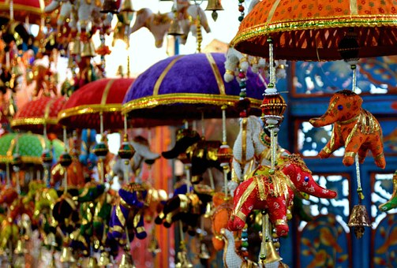
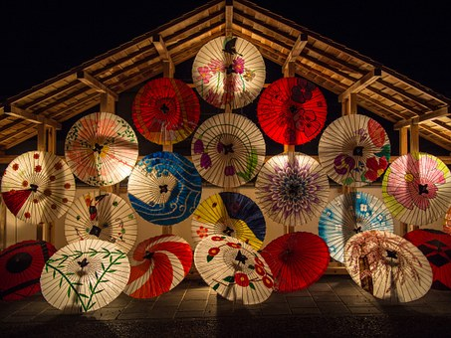


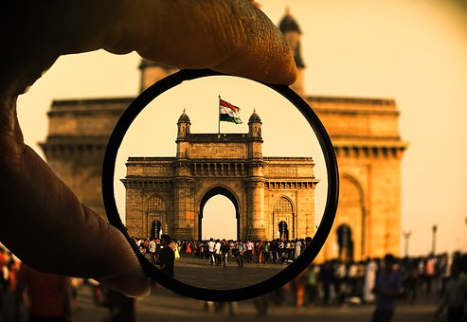
ありがとうございました

